Slide 1

Virtual Reality TCS 675
Ms. Neha Sharma
Assistant Professor
Graphic Era Hill University, Haldwani
SOC Department

Slide 2
Course Outcomes
CO1: Demonstrate an understanding of techniques, processes,
technologies and equipment used in virtual reality
CO2: Identify appropriate design methodologies for immersive
technology development, especially from a physiological
perspective
CO3: Exploit the characteristics of human visual perception in
Virtual Reality techniques
CO4: Create effective VR techniques for the Web
CO5: Effectively categorize the benefits/shortcomings of
available VR technology platforms.
CO6: Use human factors to design and evaluate a VR application

Slide 3
Syllabus UNIT 3
Bring Virtual Reality to the web: Introduction to Aframe, Transformations and Textures using Aframe, Aframe animations, Illumination, Interaction with objects, Building a complete scene using Aframe

Slide 4
Web VR
Web VR brought virtual reality to the web, making it easier for anyone to create, enjoy, and share VR experiences. The next phase of this evolution is WebXR, which will combine Web VR and AR into a single API.
WebVR is an open specification that makes it possible to experience VR in your browser. The goal is to make it easier for everyone to get into VR experiences, no matter what device you have.

Slide 5
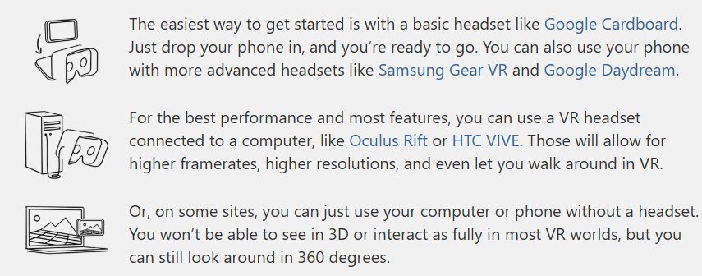
Web VR

Slide 6
What is A-Frame?
A-Frame is a web framework for building virtual reality (VR) experiences. A-Frame is based on top of HTML, making it simple to get started. But A-Frame is not just a 3D scene graph or a markup language; the core is a powerful entity-component framework that provides a declarative, extensible, and composable structure to three.js.

Slide 7
A-Frame was developed to be an easy yet powerful way to develop VR content. As an independent open source project, A-Frame has grown to be one of the largest VR communities.
A-Frame supports most VR headsets such as Vive, Rift, Windows Mixed Reality, Cardboard, Oculus Go, and can even be used for augmented reality.
A-Frame aims to define fully immersive interactive VR experiences that go beyond basic 360° content, making full use of positional tracking and controllers.

Slide 8
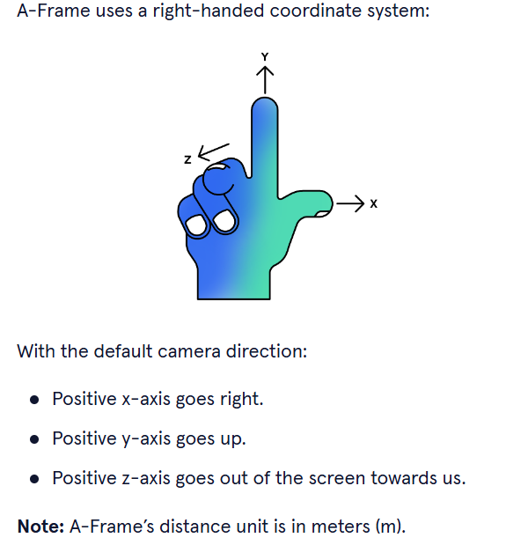

Slide 9
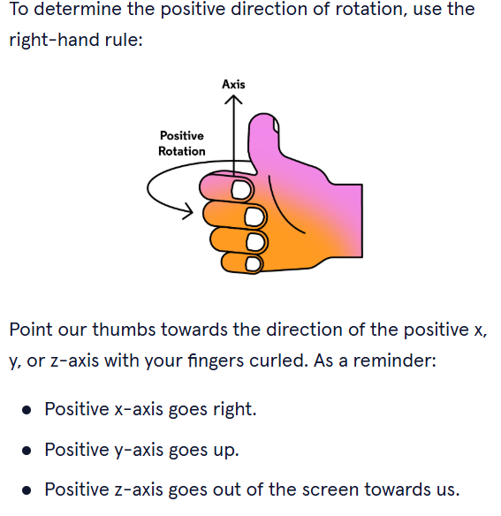

Slide 10
Features
Simple: Just drop in a <script> tag and <a-scene>. A-Frame will handle 3D boilerplate, VR setup, and default controls. Nothing to install, no build steps.
Declarative HTML: HTML is easy to read, understand, and copy-and-paste.
Entity-Component Architecture: A-Frame is a powerful three.js framework, providing a declarative, composable, reusable entity-component structure.
Cross-Platform VR: Build VR applications for Vive, Rift, Meta Quest, Windows Mixed Reality, and Cardboard with support for all respective controllers. A-Frame still works on standard desktop and smartphones.

Slide 11
Visual Inspector: A-Frame provides a handy built-in visual 3D inspector.
Performance: A-Frame is optimized from the ground up for WebVR. While A-Frame uses the DOM, its elements don’t touch the browser layout engine. 3D object updates are all done in memory with little garbage and overhead.
Components: Hit the ground running with A-Frame’s core components such as geometries, materials, lights, animations, models, raycasters, shadows, positional audio, text, and controls for most major headsets.
Proven and Scalable: A-Frame has been used by companies such as Google, Disney, Samsung, Toyota, Ford, Chevrolet, Amnesty International, CERN, NPR, Al Jazeera, The Washington Post, NASA.

Slide 12
Which Platforms Does A-Frame Support?
General platforms that A-Frame supports include:
VR on desktop with a headset
VR on mobile with a headset
VR on standalone headset
Flat on desktop (i.e., mouse and keyboard)
Flat mobile (i.e., magic window)
Some other platforms that have been shown to work with A-Frame include:
Augmented reality (AR) on AR headsets (e.g., Magic Leap, HoloLens)
Augmented reality (AR) on mobile (i.e., magic window, ARKit, ARCore)

Slide 13
Which Browsers Does A-Frame Support?
A-Frame supports VR for any browser that implements the WebXR specification, and flat 3D for most browsers.
Supermedium (available on Oculus and Steam)
Firefox
Oculus Browser
Samsung Internet
Microsoft Edge
Chrome (WebXR under origin trials)
Exokit (experimental early support)

Slide 14
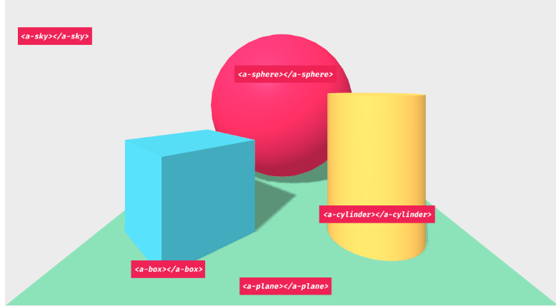
HTML
A-Frame is based on top of HTML and the DOM using a polyfill for Custom Elements. HTML is the building block of the Web. Since most of the Web was built on top of HTML, most existing tools and libraries work with A-Frame including React, Vue.js, Angular, d3.js, and jQuery.

Slide 15
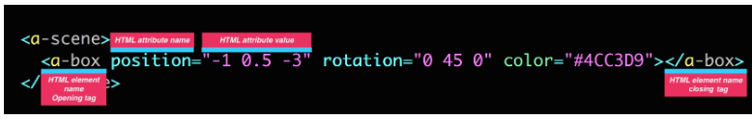
HTML
Once you pick up the general structure or syntax of HTML (opening tag, attributes, closing tag), then you’re good to go!

Slide 16
A-Frame provides a handful of elements such as <a-box> or <a-sky> called primitives that wrap the entity-component pattern to make it appealing for beginners.
<html> <head> <script src="https://aframe.io/releases/1.6.0/aframe.min.js"></script> </head> <body> <a-scene> <a-box position="-1 0.5 -3" rotation="0 45 0" color="#4CC3D9"></a-box> <a-sky color="#ECECEC"></a-sky> </a-scene> </body> </html>

Slide 17
Entity-Component-System
A-Frame is a three.js framework with an entity-component-system (ECS) architecture.
ECS architecture is a common and desirable pattern in 3D and game development that follows the composition over inheritance and hierarchy principle.
The benefits of ECS include:
Greater flexibility when defining objects by mixing and matching reusable parts.
Eliminates the problems of long inheritance chains with complex interwoven functionality.
Promotes clean design via decoupling, encapsulation, modularization, reusability.
Most scalable way to build a VR application in terms of complexity.
Proven architecture for 3D and VR development.
Allows for extending new features (possibly sharing them as community components).
3D and VR is different; there are infinite types of possible objects that have unbounded behavior. ECS provides a manageable pattern to construct types of objects.

Slide 18
Some abstract examples of different types of entities built from composing together different components:
Box = Position + Geometry + Material
Light Bulb = Position + Light + Geometry + Material + Shadow
Sign = Position + Geometry + Material + Text
VR Controller = Position + Rotation + Input + Model + Grab + Gestures
Ball = Position + Velocity + Physics + Geometry + Material
Player = Position + Camera + Input + Avatar + Identity

Slide 19
As another abstract example, imagine we want to build a car entity by assembling components:
We can attach a material component that has properties such as “color” or “shininess” that affects the appearance of the car.
We can attach an engine component that has properties such as “horsepower” or “weight” that affects the functionality of the car.
We can attach a tire component that has properties such as “number of tires” or “steering angle” that affects the behavior of the car.

Slide 20
ECS in A-Frame
A-Frame has APIs that represents each piece of ECS:
Entities are represented by the <a-entity> element and prototype.
Components are represented by HTML attributes on <a-entity>‘s. Underneath, components are objects containing a schema, lifecycle handlers, and methods. Components are registered via the AFRAME.registerComponent (name, definition) API.
Systems are represented by <a-scene>‘s HTML attributes. System are similar to components in definition. Systems are registered via the AFRAME.registerSystem (name, definition) API.

Slide 21
This syntax takes the form with a colon (:) separating property names from property values, and a semicolon (;) separating different property declarations:
<a-entity ${componentName}="${propertyName1}: ${propertyValue1}; ${propertyName2}: ${propertyValue2}">
For example, we have <a-entity> and attach the geometry, material, light, and position components with various properties and property values:

Slide 22
<a-entity geometry="primitive: sphere; radius: 1.5" light="type: point; color: white; intensity: 2" material="color: white; shader: flat; src: glow.jpg" position="0 0 -5"></a-entity>

Slide 23
HTML
<html lang="en">
<head>
<script src="https://aframe.io/releases/1.6.0/aframe.min.js"></script>
</head>
<body>
<a-scene>
<a-box position="-1 3 -5" rotation="0 45 0" color="#4CC3D9" dynamic-body >
</a-box>
</a-scene>
</body>
</html>

Slide 24
The animation component lets us animate and tween values including:
Component values (e.g., position, visible)
Component property values (e.g., light.intensity)
We can also tween values directly for better performance versus going through .setAttribute, such as by animating values:
On the object3D (e.g., object3D.position.y, object3D.rotation.z)
Directly within a component (e.g., components.material.material.color, components.text.material.uniforms.opacity.value),

Slide 25
<head>
<script src="https://aframe.io/releases/1.6.0/aframe.min.js"></script>
</head>
<body>
<a-scene>
<a-box position="-1 3 -5" rotation="0 45 0" color="#4CC3D9" dynamic-body > </a-box>
<a-box position="-1 1.6 -5" animation="property: position; to: 1 8 -10; dur: 2000; easing: linear; loop: true" color="tomato"></a-box>
</a-box> </a-scene>
</body>
</html>

Slide 26
For example, translating a box:
<a-box position="-1 1.6 -5" animation="property: position; to: 1 8 -10; dur: 2000; easing: linear; loop: true" color="tomato"></a-box>
Or orbiting a sphere in a 5-meter radius:
<a-entity rotation="0 0 0" animation="property: rotation; to: 0 360 0; loop: true; dur: 10000"> <a-sphere position="5 0 0" color="mediumseagreen"></a-sphere> </a-entity>

Slide 27
Multiple Animations
The component’s base name is animation. We can attach multiple animations to one entity by name-spacing the component with double underscores (__):
<a-entity animation="property: rotation" animation__2="property: position" animation__color="property: material.color"></a-entity>

Slide 28
Controlling Animations using setAttribute
Like any A-Frame component, the animation component can be configured from JavaScript by calling setAttribute() on an element.
By default, the animation will begin playing immediately (autoplay is true by default).
A better approach is to control the start of an animation using events
On initialization, configure all the animations that may be required on the object, with a custom event configured to start the animation.
When you want to start a specific animation, do so by using emit() rather than setAttribute().

Slide 29
Animating on Events
We can use the startEvents property to animate upon events:
<a-entity id="mouseCursor" cursor="rayOrigin: mouse"></a-entity> <a-entity geometry="primitive: box" material="color: red" animation__mouseenter="property: components.material.material.color; type: color; to: blue; startEvents: mouseenter; dur: 500"; animation__mouseleave="property: components.material.material.color; type: color; to: red; startEvents: mouseleave; dur: 500";> </a-entity>

Slide 30
Interactions & Controllers
There is no one true way for adding interactions due to variety of platforms, devices, input methods that A-Frame can support. On top of that, VR interaction is open-ended. Unlike the 2D Web where we only have to worry about mouse and touch input, we can do anything in VR: grab, throw, rub, flip, poke, stretch, press, etc. Going further, mixed reality, trackers, and custom controllers provide even more creativity in interaction!
In the 2D Web, input and interactions are handled through browser events (e.g., click, mouseenter, mouseleave, touchstart, touchend). Whenever an input-based event happens, the browser will emit an event that we can listen to and handle with Element.addEventListener:

Slide 31
Interactions & Controllers
// `click` event emitted by browser on mouse click. document.querySelector('p').addEventListener('click', function (evt) { console.log('This 2D element was clicked!'); });
like the 2D Web, A-Frame relies on events and event listeners for interactivity and dynamicity. However because A-Frame is a JavaScript framework and everything is done in WebGL, A-Frame’s events are synthetic custom events that can be emitted by any component describing any event:
// `collide` event emitted by a component such as some collider or physics component. document.querySelector('a-entity').addEventListener('collide', function (evt) { console.log('This A-Frame entity collided with another entity!'); });

Slide 32
Gaze-Based Interactions with cursor Component
Gaze-based interactions rely on rotating our heads and looking at objects to interact with them. This type of interaction is for headsets without a controller. Even with a rotation-only controller (Oculus Go), the interaction is still similar. Since A-Frame provides mouse-drag controls by default, gaze-based can sort of be used on desktop to preview the interaction by dragging the camera rotation.
To add gaze-based interaction, we need to add or implement a component. A-Frame comes with a cursor component that provides gaze-based interaction if attached to the camera:
Explicitly define <a-camera> entity. Previously, A-Frame was providing the default camera.
Add <a-cursor> entity as a child element underneath the camera entity.
Optionally, configure the raycaster used by the cursor.

Slide 33
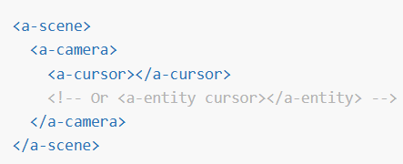

Slide 34
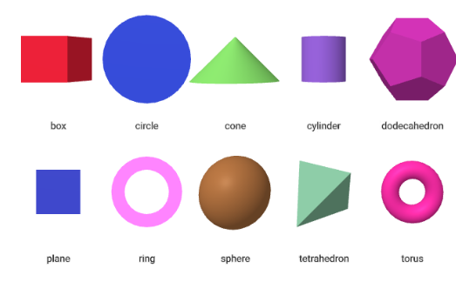
geometry
The geometry component provides a basic shape for an entity. The primitive property defines the general shape. Geometric primitives, in computer graphics, are irreducible basic shapes. A material component is commonly defined to provide an appearance alongside the shape to create a complete mesh.

Slide 35
material
The material component gives appearance to an entity. We can define properties such as color, opacity, or texture. This is often paired with the geometry component which
provides shape.
We can register custom materials to extend the material component to provide a wide range of visual effects.
Defining a red material using the default standard material:
<a-entity geometry="primitive: box" material="color: red"></a-entity>

Slide 36
Defining a red material using the default standard material:
<a-entity geometry="primitive: box" material="color: red"></a-entity>
<a-entity geometry="primitive: box" material="shader: flat; color: red"></a-entity> Here is an example of using an example custom material:
<a-entity geometry="primitive: plane" material="shader: ocean; color: blue; wave-height: 10"></a-entity>

Slide 37
Properties
The material component has some base properties.
opacity | Extent of transparency. If the transparent property is not true, then the material will remain opaque and opacity will only affect color. | 1.0
repeat | Texture repeat to be used. | {x: 1, y: 1}
shader | Which material to use. Defaults to the standard material. Can be set to the flat material or to a registered custom shader material. | standard
side | Which sides of the mesh to render. Can be one of front, back, or double. | front
transparent | Whether material is transparent. Transparent entities are rendered after non-transparent entities. | false

Slide 38
Events
materialtextureloaded | Texture loaded onto material.
materialvideoloadeddata | Video data loaded and is going to play.
materialvideoended | For video textures, emitted when the video has reached its end (may not work with loop).

Slide 39
Textures
To set a texture using one of the built-in materials, specify the src property. src can be a selector to either an <img> or <video> element in the asset management system:
<a-scene> <a-assets> <img id="my-texture" src="texture.png"> </a-assets> <a-entity geometry="primitive: box" material="src: #my-texture"></a-entity> </a-scene>

Slide 40
src can also be an inline URL
<a-scene> <a-entity geometry="primitive: box" material="src: url(texture.png)"></a-entity> </a-scene>

Slide 41
Video Textures
Whether the video texture loops or autoplays depends on the video element used to create the texture.
If we simply pass a URL instead of creating and passing a video element, then the texture will loop and autoplay by default.
To specify otherwise, create a video element in the asset management system, and pass a selector for the id attribute (e.g., #my-video):

Slide 42
<a-scene> <a-assets> <!-- No loop. --> <video id="my-video" src="video.mp4" autoplay="true"></video> </a-assets> <a-entity geometry="primitive: box" material="src: #my-video"></a-entity> </a-scene>

Slide 43
Controlling Video Textures
To control the video playback such as pausing or seeking, we can use the video element to control media playback.
var videoEl = document.querySelector('#my-video'); videoEl.currentTime = 122; // Seek to 122 seconds. videoEl.pause();

Slide 44
Repeating Textures
We might want to repeat tile textures rather than having them stretch. The repeat property can repeat textures.
<a-entity geometry="primitive: plane; width: 100" material="src: carpet.png; repeat: 100 20"></a-entity>

Slide 45
Light:illumination
The light component defines the entity as a source of light. Light affects all materials that have not specified a flat shading model with shader: flat.
<a- light color=“#AFA” intensity: 1.5" position="-1 1 0"></a-light>
By default, A-Frame scenes inject default lighting, an ambient light and a directional light

Slide 46
Whenever we add any lights, A-Frame removes the default lights from the scene.
<!-- Default lighting injected by A-Frame. --> <a-entity light="type: ambient; color: #BBB"></a-entity> <a-entity light="type: directional; color: #FFF; intensity: 0.6" position="-0.5 1 1"></a-entity>
To manually disable the defaults, without adding other lights:
<a-scene light="defaultLightsEnabled: false"> <!-- ... --> </a-scene>

Slide 47
Properties
All light types support a few basic properties:
Property | Description | Default Value
type | One of ambient, directional, hemisphere, point, spot, probe. | directional
color | Light color. | #fff
intensity | Light strength. | 1.0

Slide 48
Light Types
Ambient lights globally affect all entities in the scene. The color and intensity properties define ambient lights. Additionally, position, rotation, and scale have no effect on ambient lights.
<a-entity light="type: ambient; color: #CCC"></a-entity>

Slide 49
Directional lights are like a light source that is infinitely far away, but shining from a specific direction, like the sun. Thus, absolute position do not have an effect on the intensity of the light on an entity. We can specify the direction using the position component.
<a-entity light="type: directional; color: #EEE; intensity: 0.5" position="-1 1 0"></a-entity>
Directional lights are the most efficient type for adding realtime shadows to a scene. You can use shadows like so:
<a-light type="directional" light="castShadow:true;" position="1 1 1" intensity="0.5" shadow-camera-automatic="#objects"></a-light>

Slide 50
Hemisphere lights are like an ambient light, but with two different colors, one from above (color) and one from below (groundColor). This can be useful for scenes with two distinct lighting colors (e.g., a grassy field under a gray sky).
<a-entity light="type: hemisphere; color: #33C; groundColor: #3C3; intensity: 2"></a-entity>
Property | Description | Default Value
color | Light color from above. | #fff
groundColor | Light color from below. | #fff

Slide 51
Point lights, unlike directional lights, are omni-directional and affect materials depending on their position and distance. Point lights are like light bulb. The closer the light bulb gets to an object, the greater the object is lit.
<a-entity light="type: point; intensity: 0.75; distance: 50; decay: 2"position="0 10 10"></a-entity>
Property | Description | Default Value
decay | Amount the light dims along the distance of the light. | 1.0
distance | Distance where intensity becomes 0. If distance is 0, then the point light does not decay with distance. | 0.0

Slide 52
Spot lights are like point lights in the sense that they affect materials depending on its position and distance, but spot lights are not omni-directional. They mainly cast light in one direction, like the Bat-Signal.
<a-entity light="type: spot; angle: 45"></a-entity>
Property | Description | Default Value
angle | Maximum extent of spot light from its direction (in degrees). | 60
decay | Amount the light dims along the distance of the light. | 1.0
distance | Distance where intensity becomes 0. If distance is 0, then the point light does not decay with distance. | 0.0
penumbra | Percent of the spotlight cone that is attenuated due to penumbra. | 0.0
target | element the spot should point to. set to null to transform spotlight by orientation, pointing to it’s -Z axis. | null

Slide 53
Probe lights are kind of like ambient lighting in that they don’t have a particular source or direction and light everything equally.
Where they differ though is that they will color each angle differently based upon a spherical harmonic.
Property | Description | Default Value
intensity | Amount of light provided | 1
envMap | Cube Map to load | null

Slide 54
Unit 4
Navigation in Virtual Reality: Position, Orientation, Maneuvering, Exploration, Travel characteristics, Wayfinding in VR
Menus and Text in VR: 2D menus, 3D menus, Tool Belt Menu,CUbic Menu, Tangible Interfaces, Gestural Commands, Voice
Commands, Text Input
Haptics: Human Haptics, Kinesthetic system, Motor system,Haptic Devices and Interfaces

Slide 55
In Virtual Reality (VR), navigation involves controlling a user's position, orientation, and movement within a virtual environment.
This is typically achieved through a combination of hardware (headset, controllers, trackers) and software techniques that interpret user input and translate it into virtual actions.
Different navigation methods, like walking-in-place, steering, and manipulation-based techniques, offer diverse approaches to exploring and maneuvering in VR.

Slide 56
1. Position and Orientation Control:
Tracking:
VR headsets use sensors and trackers to monitor the user's head and hand movements in real-time.
Mapping:
This data is then used to update the user's position and orientation within the virtual environment.
Virtual Camera:
The virtual camera's position and orientation are directly linked to the user's real-world position and orientation, creating a sense of immersion

Slide 57
2. Maneuvering and Movement:
Walking-in-Place:
Users can simulate walking by making movements within a limited real-world space, which are translated into forward, backward, and lateral movement in the virtual environment.
Steering:
A more fluid way to navigate involves using a joystick or other input device to control the direction and speed of the user's movement.
Teleportation:
A quick and easy way to jump between different locations within the virtual world.
Redirection:
A technique that allows users to move freely in the virtual world while being constrained by their limited real-world space.
Manipulation-Based Techniques:
Users can manipulate the virtual world or the virtual camera itself, using gestures or other controls, to control their position and orientation.

Slide 58
3. Navigation Techniques
Exploration: Navigating to gather information about the environment.
Search: Finding a specific location or object within the virtual world.
Maneuvering: Making small, precise movements to examine objects or features from different perspectives.

Slide 59
4. Factors Influencing Navigation
Sickness: Uneven or unrealistic movement in VR can cause simulator sickness, so navigation techniques need to be carefully designed.
Presence: How effectively the user feels like they are in the virtual environment.
Usability: How easy and intuitive the navigation techniques are to use.

Slide 60
In VR, exploration is fundamental for understanding and navigating immersive environments, requiring rapid and accurate scene knowledge. Wayfinding, the process of navigating and orienting oneself, is crucial for successful exploration and relies on external information and mental processes. Travel characteristics in VR include immersive experiences, virtual booking interfaces, and the ability to explore destinations before travel.

Slide 61
Exploration in VR
Scene knowledge:
Effective exploration techniques help users quickly understand and learn about the virtual environment, which is vital for decision-making.
Immersive experience:
VR offers a 360-degree immersive experience, allowing users to virtually visit locations and explore them in detail.
Accessibility and cost-effectiveness:
VR can provide a safe and convenient way to explore remote locations that may be difficult or expensive to reach physically.
Wayfinding in VR:
Mental navigation:
Wayfinding involves the cognitive process of defining a path through an environment, using and acquiring spatial knowledge, and relying on both natural and artificial cues.

